Slide 1

Summer Internship Evaluation
Java Backend & Cloud Engineering Intern
IILM University, Greater Noida · School of Computer Science and Engineering
Student: DIVYANSHU TIWARI
Roll No: CS-2341805
Program: B.Tech CSE | 7th Semester | Batch 2026–27
Organization: Code-B Solutions Pvt. Ltd.
Duration: March 2026 – August 2026
Role: Java Backend & Cloud Engineering Intern

Slide 2

Internship Overview
Organization
Code-B Solutions Pvt. Ltd., Mumbai (Remote)
Role
Java Backend & Cloud Engineering Intern
Duration
March 2026 – August 2026 · 6 Months
Primary Focus
Backend development, REST API design, cloud deployment, and DevOps practices
Bridging academic concepts with production-oriented software engineering — designing, developing, testing, and deploying scalable backend services using Java and Spring Boot.

Slide 3

Internship Objectives
1
Strengthen Java & OOP Design
Deepen programming fundamentals and object-oriented principles
2
Production-Grade REST APIs
Build APIs using Spring Boot with real-world reliability standards
3
Scalable Backend Architecture
Understand distributed systems and scalable service design
4
Cloud & DevOps Mastery
Deploy on AWS EC2, containerize with Docker, and automate CI/CD

Slide 4
Technology Stack
Backend & Framework
Database & Cloud
DevOps & Containers
Java · Spring Boot · Spring Security · Spring Data JPA · RESTful APIs
PostgreSQL · AWS EC2
Docker · GitHub Actions · CI/CD · Git · Maven · Linux
Testing & API Tools
Project Management
JUnit · Integration Testing · API Contract Testing · Postman
JIRA

Slide 5

Backend Development & REST API Engineering
What Was Built
15+ production-grade REST APIs designed and deployed using Spring Boot
Implemented centralized exception handling and input validation across all APIs
Maintained consistent API response contracts for reliable client integration
Applied Domain-Driven Design and clean engineering principles
Worked across distributed service boundaries with reliable inter-service communication
Service Layer
Business logic and orchestration
REST API Layer
Spring Boot controllers and validation
Client Request
HTTP request to REST API

Slide 6

Database Optimization & Performance
Challenge
Approach
Result
High database query latency was degrading backend response times and overall user experience
Schema optimization, advanced indexing strategies, query execution plan analysis, and PostgreSQL best practices for distributed queries
~45% reduction in database query latency with measurable improvement in backend throughput and user experience

Slide 7




Cloud Deployment & DevOps Pipeline
Developer
GitHub Actions
Code pushed to Git Repository
CI/CD pipeline triggered automatically
Docker
AWS EC2
Services containerized for consistent environments
Production backend deployed to cloud
This automated workflow improved deployment efficiency, consistency, and significantly reduced manual intervention in production releases.

Slide 8
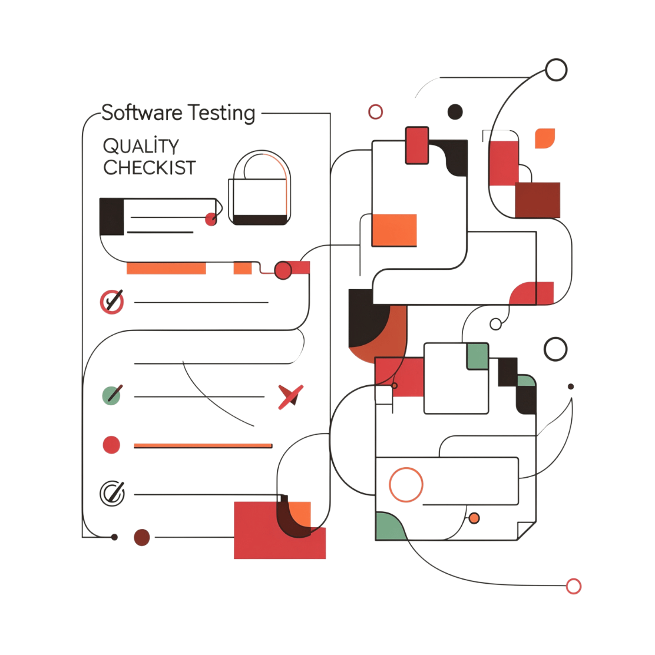

Reliability & Quality Engineering
Quality Embedded in the Development Lifecycle
Centralized Error Handling
Input Validation
Unit & Integration Testing
Comprehensive validation enforced at all API boundaries
Standardized exception management across all distributed services
JUnit and integration tests ensuring code reliability at every layer
API Contract Testing
Verified contracts to prevent breaking changes across services
~30% improvement in backend reliability across distributed service boundaries

Slide 9
Performance & Scale Metrics
15+
10K+
REST APIs
Monthly Requests
Production-grade endpoints designed and deployed
Served reliably across distributed services
45%
30%
Latency Reduction
Reliability Gain
Achieved through database optimization and indexing
Improvement in backend reliability via quality engineering
These metrics reflect exposure to production-oriented concerns: scalability, latency optimization, reliability, and fault isolation in distributed systems.

Slide 10
Key Contributions & Technical Learning
Contributions
Technical Learning
REST API development and backend architecture design
Production-grade backend architecture and scalable system design
Exception handling, input validation, and API contract reliability
Advanced database optimization and performance tuning
PostgreSQL optimization and AWS EC2 deployment
Cloud deployment, containerization, and DevOps workflows
Docker containerization and CI/CD pipeline implementation
Professional API design, testing, and reliability practices
Unit, integration, and API contract testing

Slide 11

Conclusion & Career Impact
The internship transformed academic understanding of backend development into practical experience with production-oriented software engineering — from API design to cloud deployment.
Backend Expertise
Java, Spring Boot, and scalable REST API design at production scale
Cloud & DevOps
Hands-on AWS, Docker, and CI/CD automation in real workflows
Database Performance
Optimization and reliability engineering at scale
Career Foundation
Strong base for backend, cloud, and distributed systems engineering
Thank You — Questions & Discussion

